Slide 1

Department of Information Technology
NBA Accredited
A.P. Shah Institute of Technology
G.B.Road, Kasarvadavli, Thane (W), Mumbai-400615
UNIVERSITY OF MUMBAI
Academic Year
2023-2024

Slide 2


FitGeek: Modelling ML Based Recommendation
System For Fitness And Wellness
Submitted in partial fulfillment of the degree of
Bachelor of Engineering (Sem-8) in
INFORMATION TECHNOLOGY
By
Shreya Mahajan (20104001)
Saniya Dutta (20104041)
Anish Bhosale (20104033)
Under the Guidance of
Prof. Randeep Kaur Kahlon

Slide 3

1.Project Conception and Initiation

Slide 4
1.1 Abstract
At FitGeek, we're not just another fitness website – we're a dynamic wellness platform designed to empower you on your journey towards optimal health and vitality. Our approach is all about tailoring solutions to fit your unique needs, preferences, and goals. Whether you're aiming to lose weight, build muscle, or improve overall well-being, we're here to guide you every step of the way. With our commitment to providing the latest research and best practices in healthcare, we ensure that you're always equipped with the knowledge to make informed decisions. FitGeek isn't just a stop on your wellness journey; it's a lifestyle that embraces both physical and mental health, helping you lead a happier, healthier life.

Slide 5
1.2 Objectives
To Offer Instructional Exercises with Animations along with personalized workout plans: To provide exercises with clear instructions, animated demonstrations and with timer.
To Enable Remote Access to Exercises and hydration calculator: To facilitate remote access to exercises via web and also a hydration calculator to keep track of the users water intake in a day.
To determine the stress level of the user: Stress levels are assessed utilizing the Perceived Stress Scale, a standardized tool that categorizes individuals into low, moderate, or high stress categories based on their self-reported perceptions of stressors.
Tailored Diet Recommendations: Diet recommendations are provided based on users' unique body statistics, goals, and health considerations.

Slide 6
1.3 Literature Review
SR. NO | TITLE | KEY FINDINGS | YEAR
1. | (Base Paper) Strength Training: A Fitness Application for Indoor Based Exercise Recognition and Comfort Analysis | Device monitors weight and user activities by using IMU using algorithm of LDA and SVM Several challenges were identified such as Accuracy limitations in exercise recognition algorithms, Challenges in comfort analysis, Discrepancies between predicted and actual user comfort levels. | 2020

Slide 7
1.3 Literature Review
SR. NO | TITLE | KEY FINDINGS | YEAR
2. | Preventing Data Manipulation and Enhancing the Security of data in Fitness Mobile Application | Factors influencing fitness video communication on Bilibili include theme, subtitles, duration, fan base, uploader gender, and nationality. Several challenges were identified, such as Complexity in implementing robust security measures, Potential performance impacts, User resistance to stringent security measures | 2022

Slide 8
1.3 Literature Review
SR. NO | TITLE | KEY FINDINGS | YEAR
3. | Design and implementation of fitness management website | It focuses on the adoption of blockchain for verifying academic credentials, particularly diplomas. Several challenges were identified, including User interface design challenges, Accessibility concerns, Integration issues with various technologies, Security vulnerabilities with personal health data | 2022

Slide 9
1.3 Literature Review
SR. NO | TITLE | KEY FINDINGS | YEAR
4. | The iFit: An Integrated Physical Fitness Testing System to Evaluate the Degree of Physical Fitness of the Elderly | IoT architecture for public fitness equipment improves physical fitness by providing efficient exercise and personalized prescriptions. Several challenges were identified such as concerns about the accuracy and reliability of the fitness testing system, potential discomfort for elderly users, ethical considerations regarding privacy and consent. | 2020

Slide 10
1.3 Literature Review
SR. NO | TITLE | KEY FINDINGS | YEAR
5. | Prediction of New Media Communication of Fitness Culture and Its Influence Factors | Automatic indoor exercise and comfort analysis system with 95.3% accuracy for activity recognition and 99.4% accuracy for repetition count. Automatic indoor exercise recognition and comfort analysis system may be expensive and have accuracy issues depending on the quality of devices and the user’s technique. | 2017

Slide 11
1.4 Problem Definition
There is a crucial need for education campaigns to raise awareness about the importance of seeking reliable fitness information and the potential risks associated with following unverified advice.
Local fitness groups and subsidized programs can play a role in providing cost-effective options for individuals to access proper guidance. Collaboration between governments, healthcare organizations, and fitness professionals can contribute to community initiatives that promote accurate information and inclusivity.
Without proper supervision, individuals may push themselves beyond their limits, risking overexertion. This can lead to burnout, increased susceptibility to injuries, and a negative impact on overall well-being
Access to proper fitness guidance is economically unfeasible for many individuals.

Slide 12
1.5 Scope
Enhanced Fitness Progress: AI-powered recommendations adapt as users progress, ensuring optimal workout plans having 3 levels i.e. Beginner, Intermediate, Expert.
Calorie Intake Tracker and Analysis: Implement algorithms for analyzing calorie intake against individual.
Personalized Diet Plans: Incorporate nutritional analysis to ensure users receive balanced and tailored dietary recommendations.
Hydration Calculator: Develop a hydration calculator that calculates daily water intake needs based on user profiles, activity levels, and in intervals.
Stress Level Assessment: HealthGeek assesses stress levels through a Perceived Stress Score (0-13 Low Stress, 14-26 Moderate, 26+ High), derived from responses to 10 distinct questions..

Slide 13
1.5 Scope
Mental Health Practices: Integrate mental health practices, including mindfulness and meditation exercises and offer guided sessions and resources (professional help if needed) to improve mental well being based on Low, Moderate, High levels of stress.
User Engagement and Tracking: Implement tracking features to monitor users’ adherence to recommendations and progress towards wellness goals.

Slide 14
1.6 Technology stack
Frontend : WEB X.O
HTML : for structure
CSS : for styling
JavaScript : for interactive elements
Bootstrap : CSS framework for responsive and attractive designs
Backend:
Django : framework for web application development
Python : for backend logic

Slide 15
1.6 Technology stack
Libraries: Data Analysis
Pandas
NumPy
Matplotlib
For Machine Learning related features:
Scikit-learn: For building disease prediction models.
TensorFlow or PyTorch: Building recommendation and machine learning models.
Streamlit: For Machine Learning models.

Slide 16
1.6 Technology stack
ML Algorithms:
K-Nearest Neighbours: for classification and regression tasks of the diet recommender.
Support Vector Machine: For classifying individuals into one of two classes i.e diabetic or non-diabetic, in the diabetes predictor.
Content-Based Filtering: For exercise recommendation system (suggesting workout plan based on 3 levels and 5 different parts to train).
Natural Language Processing: To determine the stress levels of the user based on the inputs provided.
Logistic Regression: To predict stress levels categorised into different classes(e.g. low, moderate, high).

Slide 17
1.7 Benefits for Environment & Society
FitGeek's innovative approach to wellness not only addresses individual well-being but also contributes to environmental and societal benefits.They are:
Promoting a Healthier Society: FitGeek's accessible and affordable wellness solutions contribute to improved overall health, benefiting society as a whole.
Inclusivity and Affordability: FitGeek ensures economic inclusivity, making fitness resources available to individuals from diverse backgrounds.
Community Building: FitGeek fosters a vibrant community, promoting social interactions, motivation, and support for individuals on their fitness journeys.
Remote Access to Exercises: Enabling remote access to exercises enhances convenience and reduces the environmental impact associated with commuting to fitness centers.
Integration of Mental Health Practices: The holistic approach includes mental health practices, contributing to destigmatizing mental health and enhancing overall well-being.

Slide 18
2. Project Design

Slide 19
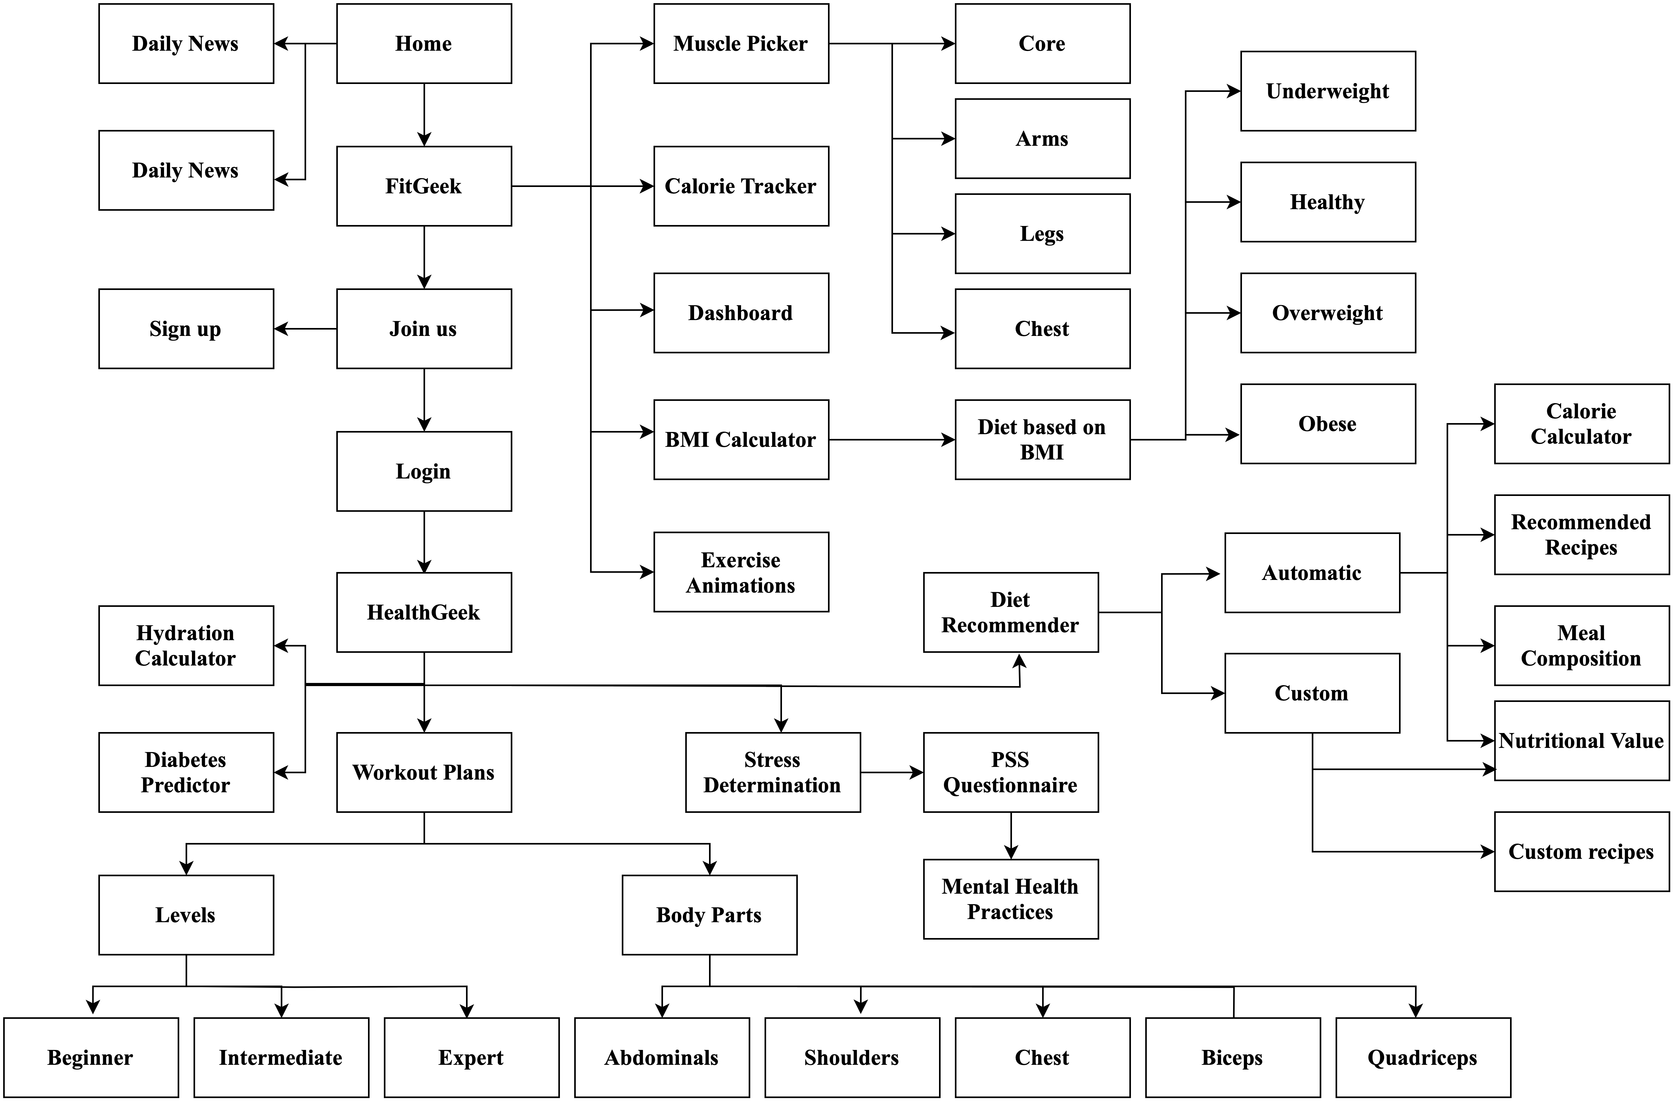
2.1 Proposed System

Slide 20
2.1 Proposed System
FitGeek, an advanced wellness platform, utilizes cutting-edge technology for personalized and cost-effective fitness guidance, addressing both physical and mental wellness. The scalable architecture ensures seamless experiences across devices with a user-friendly interface, robust backend server.
FitGeek's intuitive dashboard, developed with modern web technologies, provides personalized workout plans, nutrition dietary options, mental health practices, and progress tracking tools.
Frontend development leverages HTML, CSS, and Bootstrap for sleek and visually appealing interfaces, while also using Django framework for development. Visual Studio Code (VS Code) is chosen as the primary code editor for its popularity, robust features, and seamless integration capabilities, enhancing the team's workflow for streamlined and effective development.

Slide 21
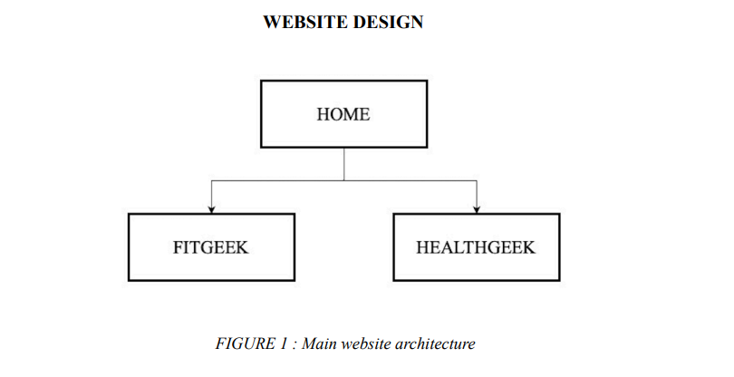
2.2 Design (Flow Of Modules)
The main website architecture

Slide 22
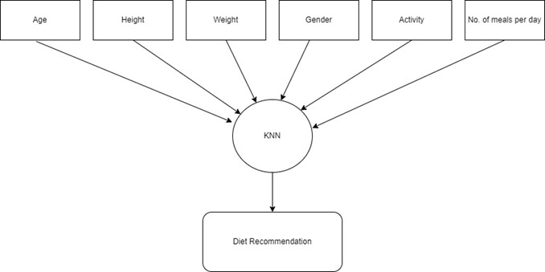
2.2 Design Flow (Diet recommendation system)
K-Nearest Neighbors for Diet Recommendation System

Slide 23
2.2 Design (Flow Of Modules)
FitGeek's sophisticated design integrates two domains: FitGeek and HealthGeek.
FitGeek offers modules like an Exercise Recommender, Calorie Tracker, Muscle Picker, and BMI Calculator, Diet, Trainers, Appointments.
HealthGeek includes a Hydration Calculator, Diet Recommender, Stress Level Predictor, Workout Plan and Diabetes Predictor.
Seamless cross-domain integration and a secure layer ensure personalized wellness solutions.

Slide 24
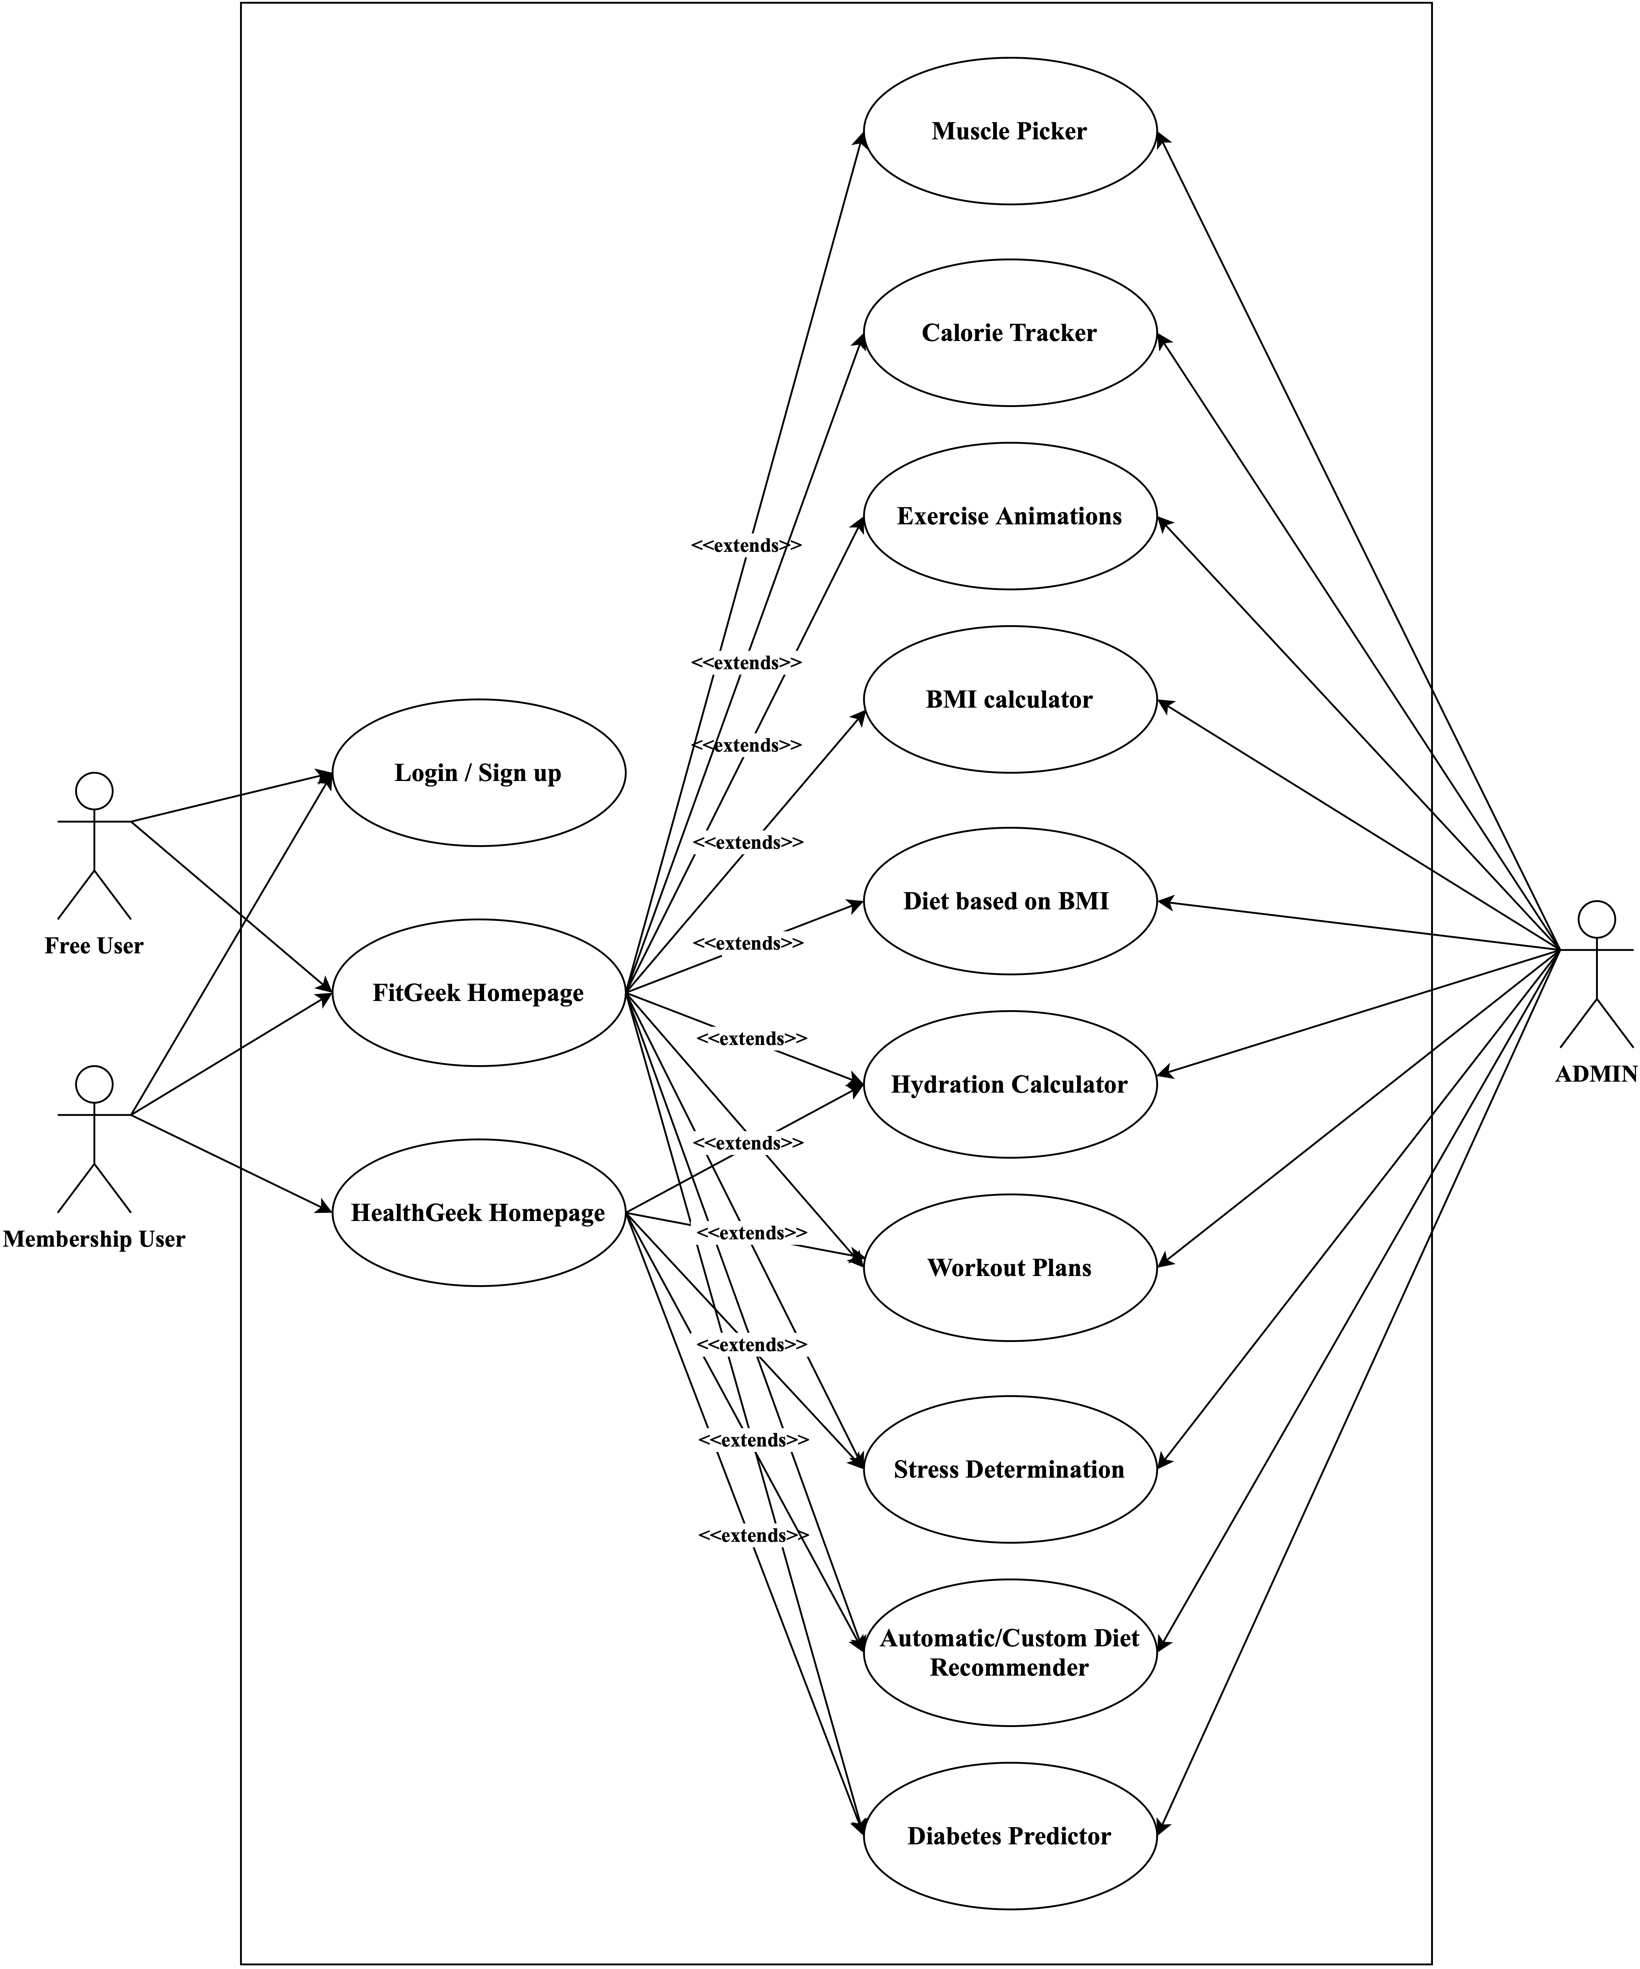
2.3 Use Case Diagram

Slide 25
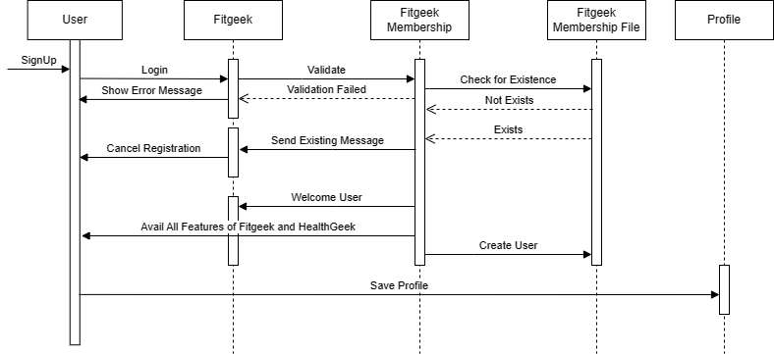
2.3 Sequence Diagram

Slide 26
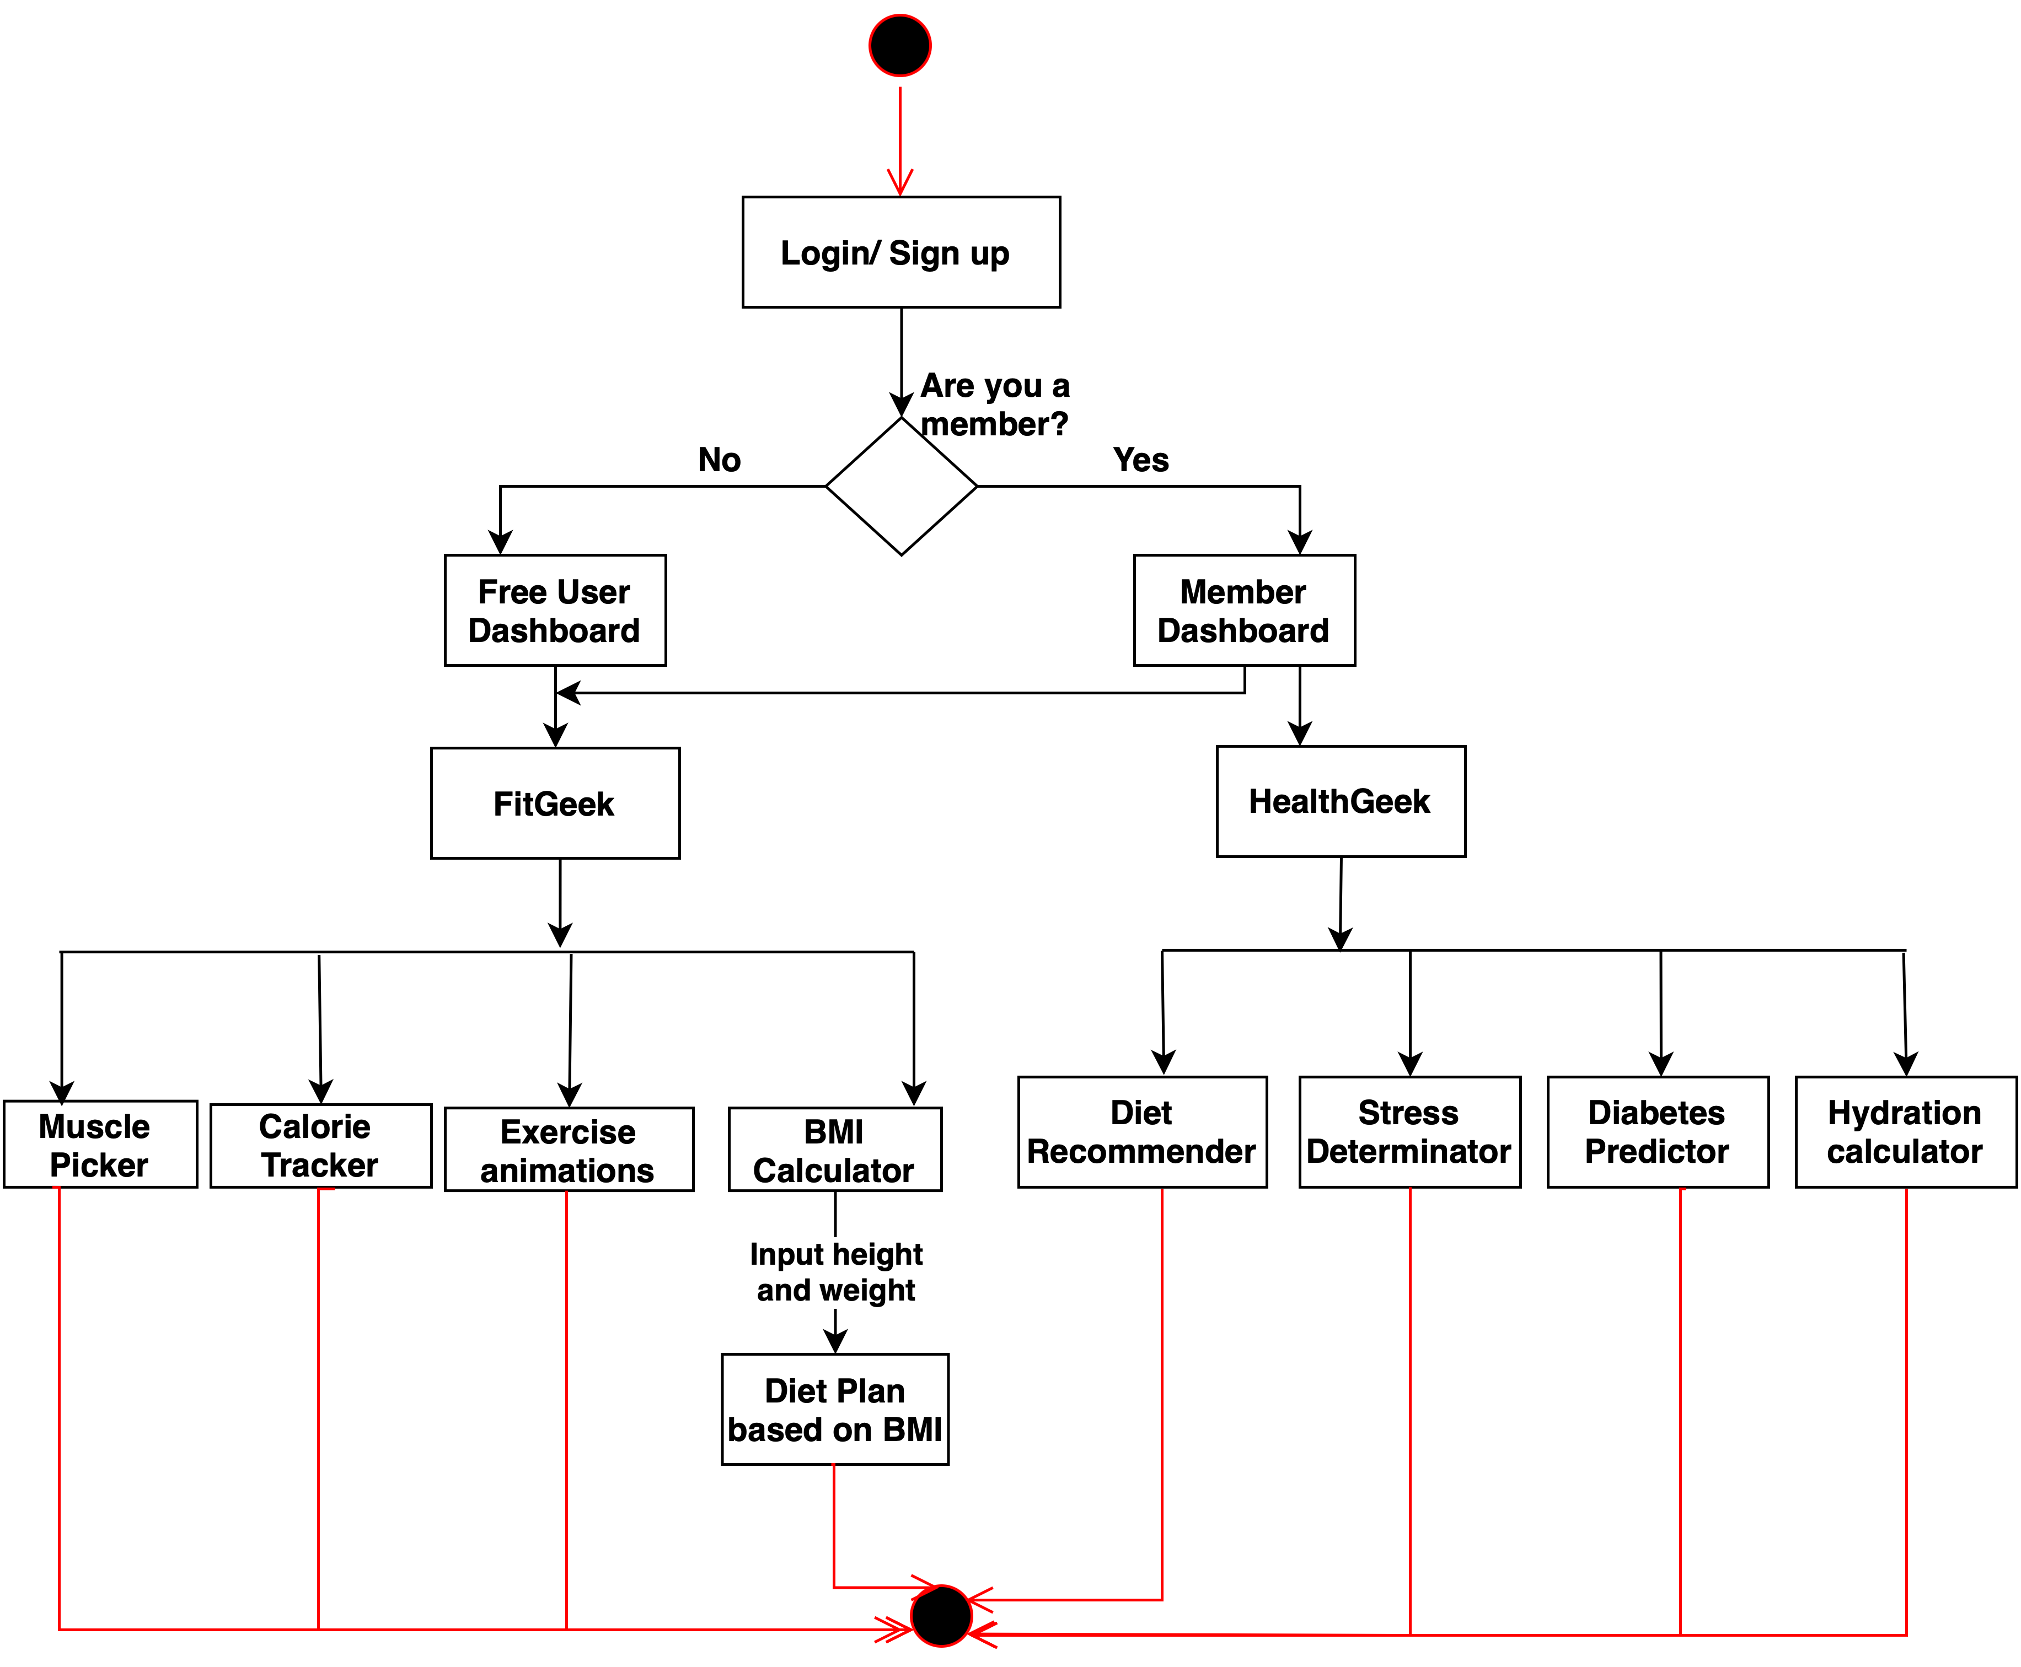
2.4 Activity Diagram

Slide 27
3. Implementation

Slide 28
3.1 Implementation Status
Following features have been completed:
Home
Fitgeek:
Muscle picker
Appointments
Diet
Dashboard
Calorie Tracker
Exercises tab
BMI calculator
Healthgeek:
Diet Recommendation system (Automatic and Custom)
Exercise Recommendation System (Workout Plan)
Stress level determination
Hydration Calculator

Slide 29
4. Result

Slide 30
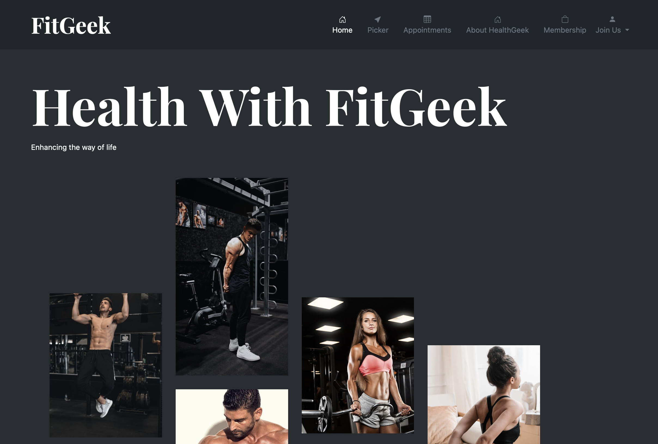

Homepage
About HealthGeek

Slide 31
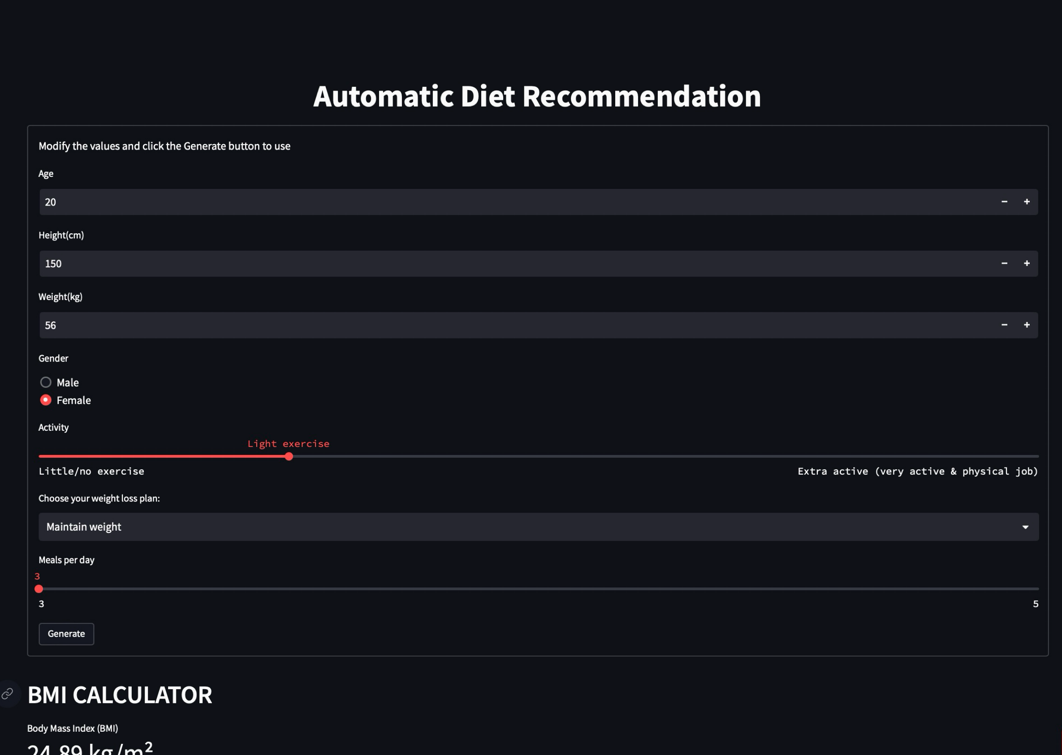
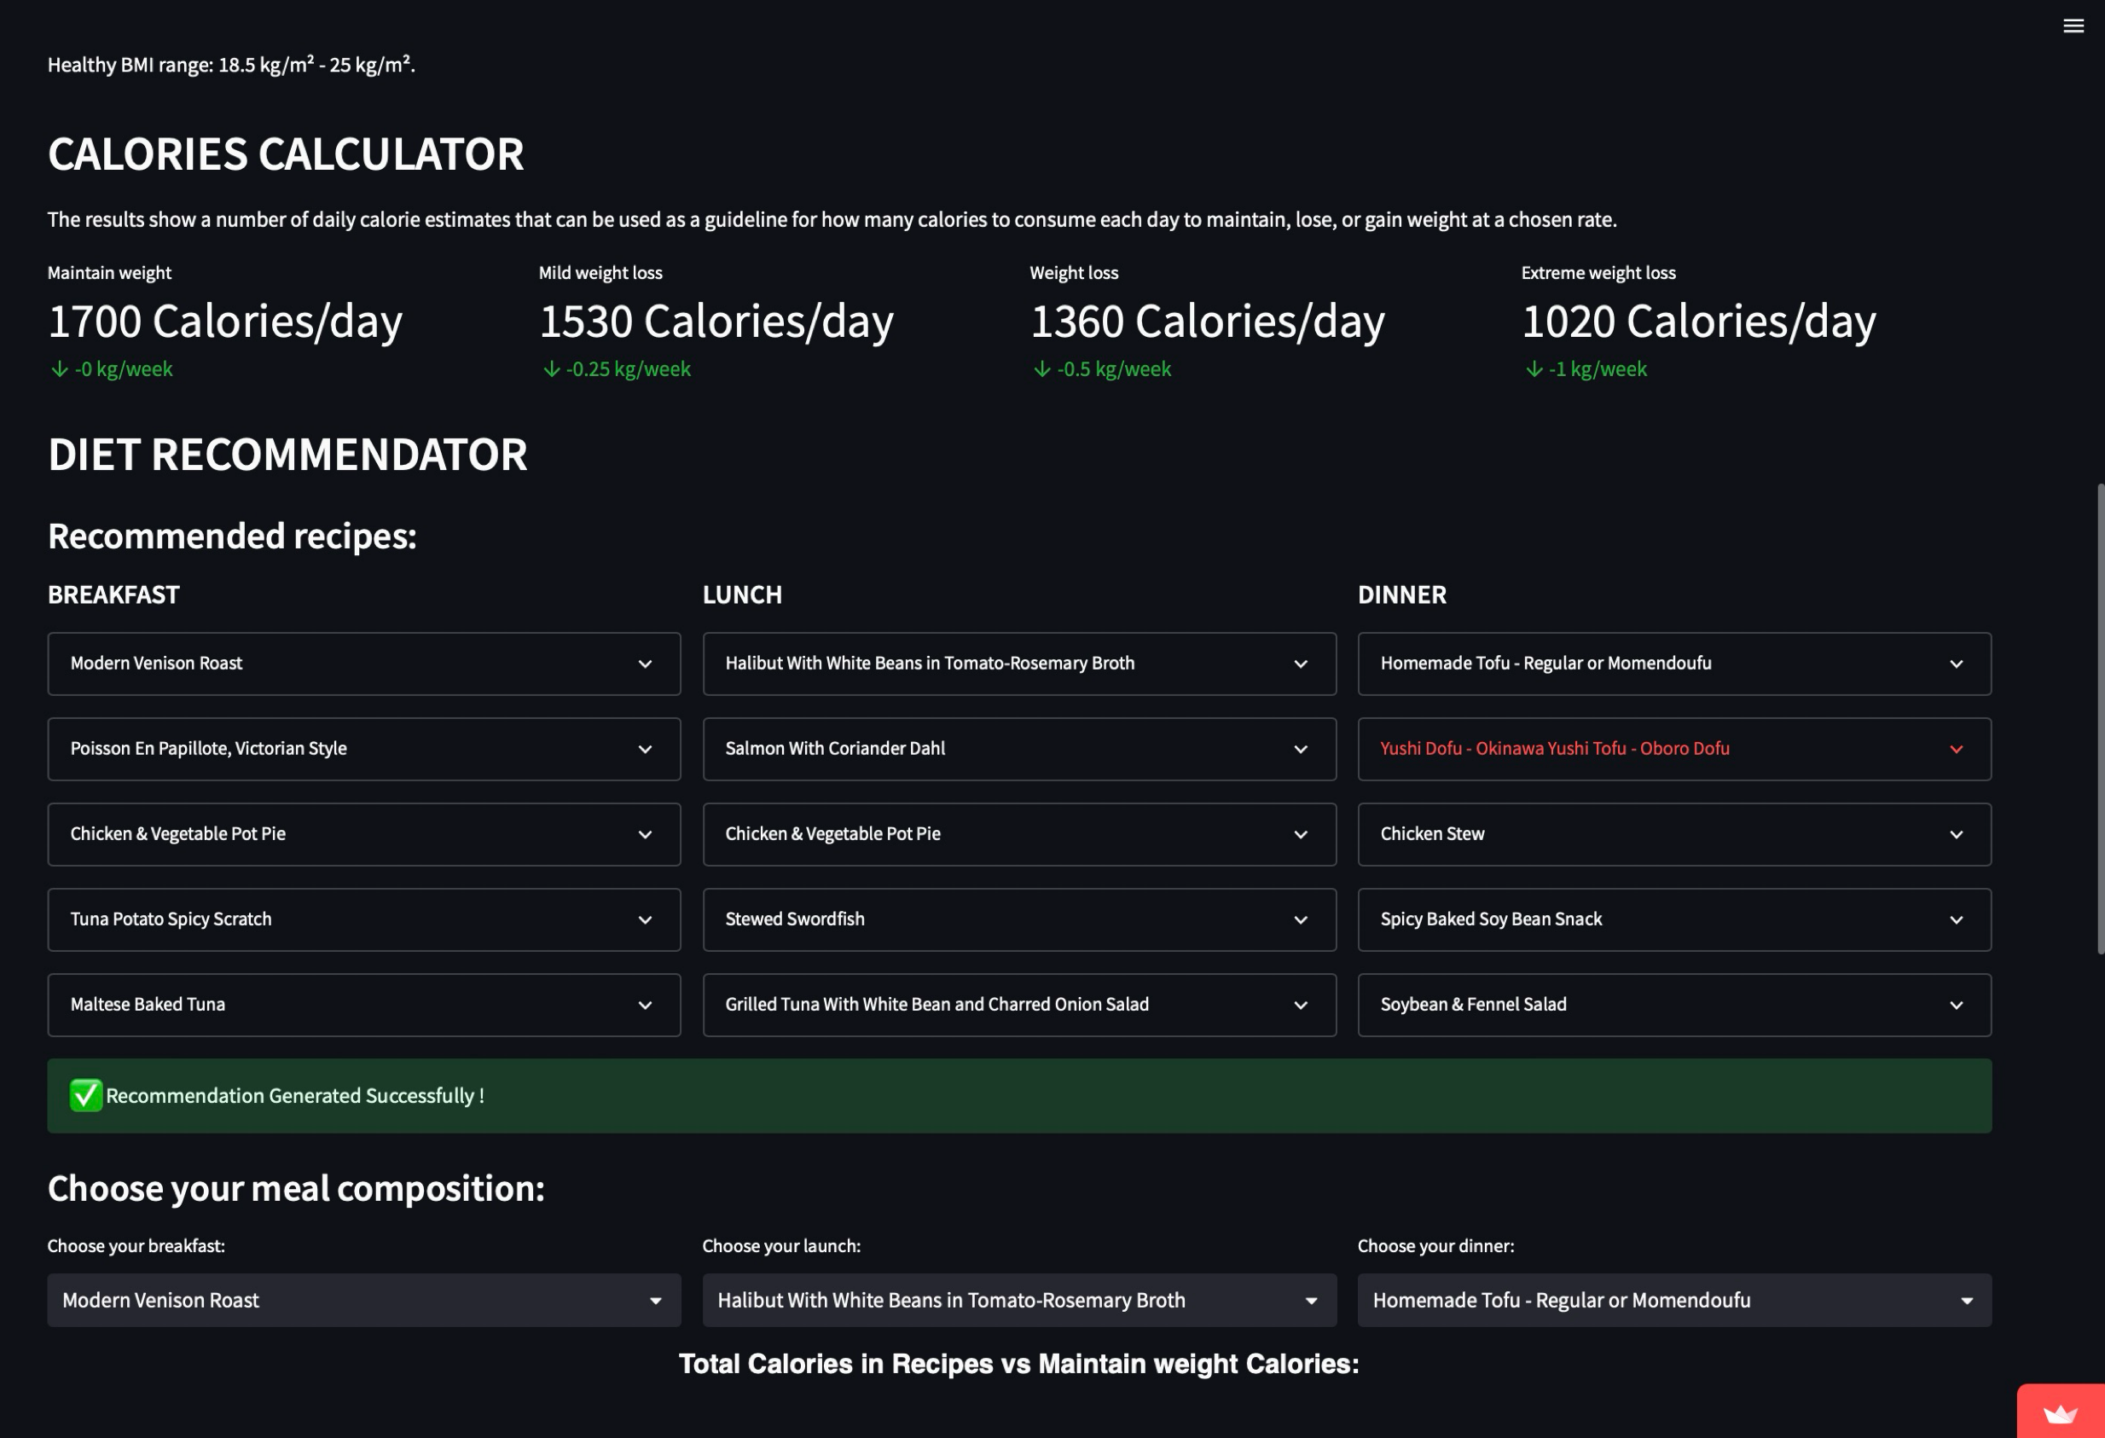
Atomatic Diet Recommendation

Slide 32
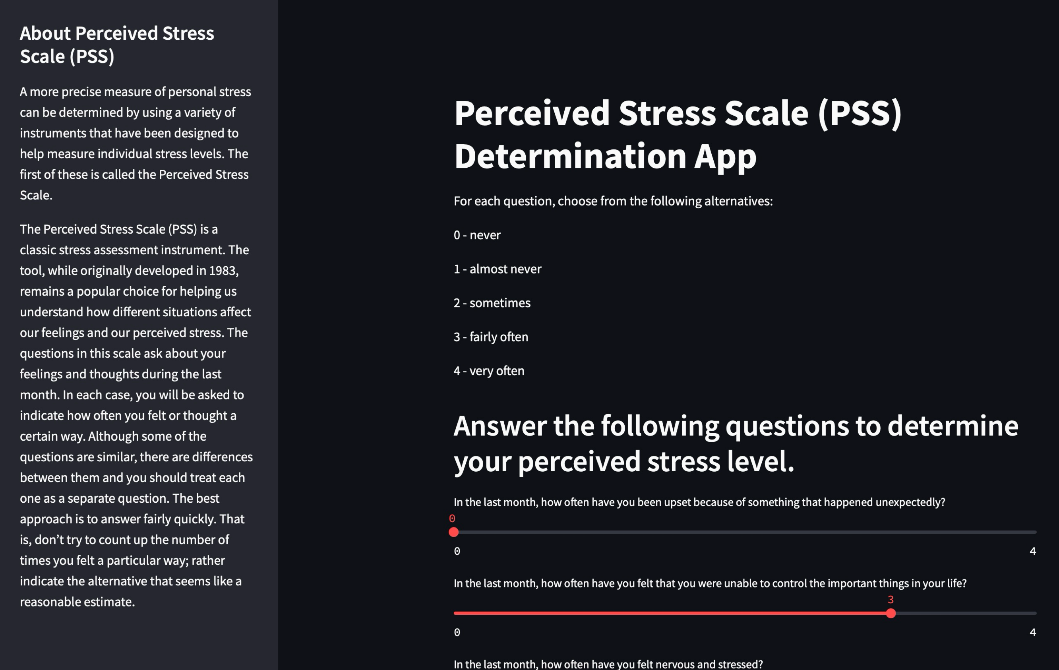
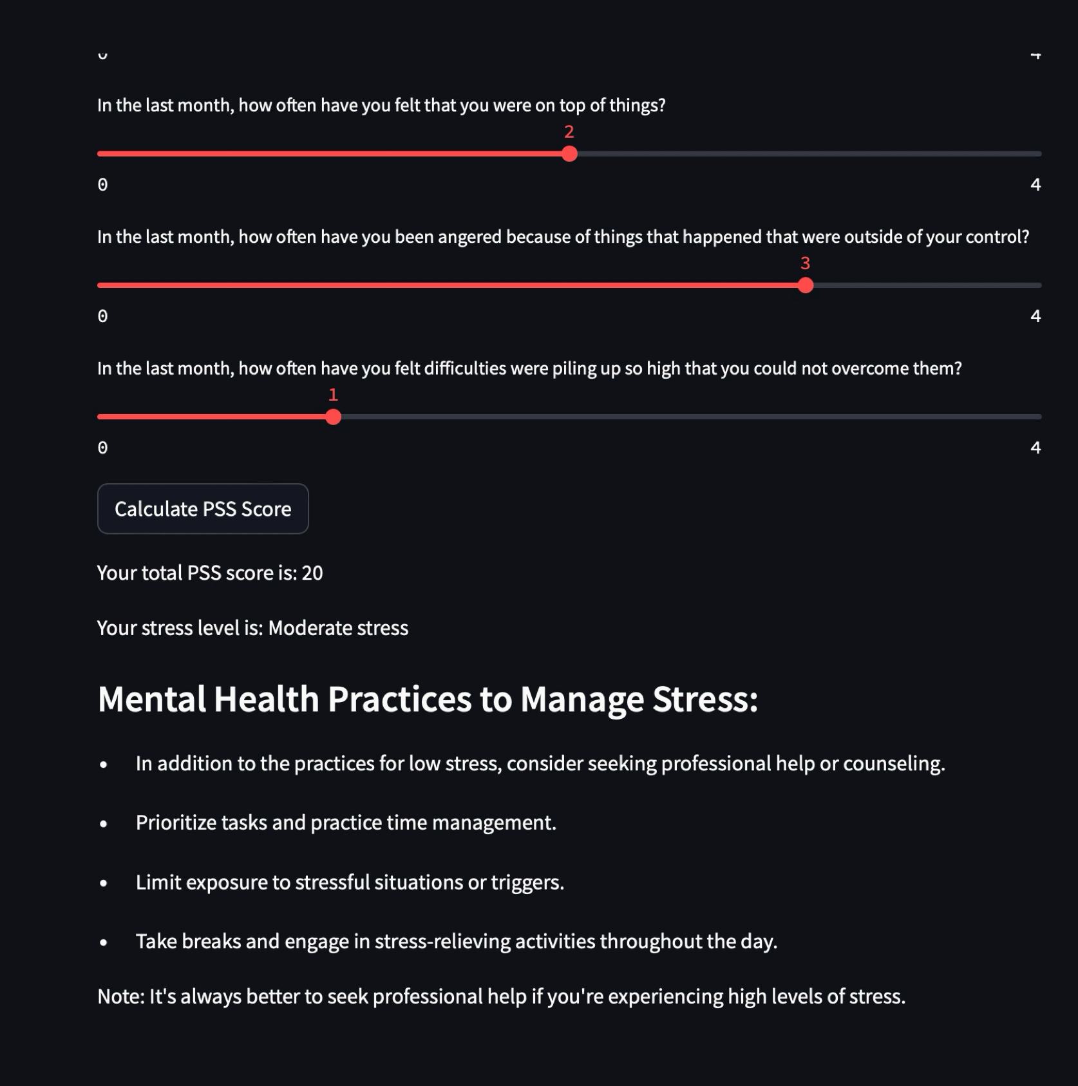
Stress Level Determination

Slide 33
5. Conclusion and Future
Scope

Slide 34
5.1 Conclusion & Future Scope
In wrapping up, FitGeek is really leading the charge in this whole health and wellness revolution, showing us just how much technology can do for our well-being. With its personalized fitness plans, cool interactive tools, and supportive community vibe, FitGeek is giving people the power to take control of their health like never before. It's like having your own personal coach right in your pocket, making getting fit easier, more fun, and safer for folks all around the world. Plus, with those fancy algorithms and loads of helpful content, FitGeek has created this awesome all-in-one place where anyone can start their wellness journey with total confidence.

Slide 35
5.1 Conclusion & Future Scope
Looking forward, we at FitGeek see a bright future ahead. We're excited about the possibilities of refining our algorithms even further to offer more personalized and effective fitness plans for each user. Additionally, integrating more health metrics and collaborative features with wearables is on our radar to enhance the overall user experience. We're also keen on establishing partnerships with healthcare providers, leveraging the insights from our data to promote preventive health measures. Furthermore, we're exploring avenues to expand our content to cover emerging wellness trends and exploring immersive technologies like augmented reality to elevate workout experiences. Our dedication to accuracy, user-centric design, and data security positions us as a pioneering force in the evolving landscape of health technology. We're committed to ongoing innovation, striving to improve lives through comprehensive well-being solutions.

Slide 36
References
[1] Dipankar Das; Shiva Murthy Busetty, ”Strength Training: A Fitness Application for Indoor Based Exercise Recognition and Comfort Analysis,” Automatic indoor exercise recognition and comfort analysis system with 95.3 accuracy for activity recognition and 99.4 accuracy for repetition count. [Online].
[2] N. Jain, A. K. Sharma, and N. Khare, ”Comprehensive Study of Routing Protocols in Mobile Ad Hoc Networks,” 2020 Second International Conference on Inventive Research in Computing Applications (ICIRCA), Coimbatore, India, 2020, pp. 635-640, doi: 10.1109/ICIRCA49882.2020.10074213.
[3] S. Kumar, R. Chauhan and N. Kumar, ”Survey and Comparative Analysis of Energy Efficient MAC Protocols for WSN,” 2020 International Conference on Smart
Electronics and Communication (ICOSEC), Trichy, India, 2020, pp. 647-651, doi:
10.1109/ICOSEC49091. 2020.9195622.
[4] S. Raza, M. Akbar, M. Akhtar, M. Ismail, and M. J. Gondal, ”Energy-Efficient
Routing Protocols in Wireless Sensor Networks: A Survey,” 2021 IEEE Access, vol. 9, pp. 29526-29548, 2021, doi: 10.1109/ACCESS.2021.3066002.

Slide 37
References
[5] P. Lal, R. Kumar and R. Kumar, ”A Comprehensive Study and Comparative Analysis of QoS in Ad Hoc Networks,” 2017 9th International Conference on Computational
Intelligence and Communication Networks (CICN), Gwalior, India, 2017, pp. 188-192, doi: 10.1109/CICN.2017.8260796.
[6] K. Agrawal, G. B. Singha and A. K. Luhach, ”A Comprehensive Survey of Mobile Agent Migration in WSNs,” 2012 Ninth International Symposium on Pervasive Systems, Algorithms and Networks, San Marcos, TX, USA, 2012, pp. 118-123, doi: 10.1109/ISPAN.2012.6265373

Slide 38
Publication
Status: Accepted and Presented
Conference: International Conference on Advanced Communication, Energy and Big Data (ICACEBD-24)
Track Name: ICACEBD2024
Paper ID: 62
Paper Title: FitGeek: Modelling ML Based Recommendation System for fitness and wellness
Abstract: FitGeek is revolutionizing wellness by making well-being accessible to all through personalized solutions driven by cutting-edge technology. At its core, FitGeek tailors fitness related plans like diet or exercises using machine learning, catering to individual preferences and goals while fostering a vibrant community of enthusiasts and experts. Prioritizing accessibility and affordability, the platform offers clear, animated exercises and user-friendly guidance. Additionally, FitGeek ensures users stay informed with healthcare updates and provides remote access to exercises. Integrating disease predictors, personalized diet suggestions, stress estimation tool, and mental health practices, FitGeek stands as a lifelong partner in the pursuit of holistic well-being, aiming to make fitness an achievable and enjoyable journey for everyone.

Slide 39
Thank You

